Slide 1

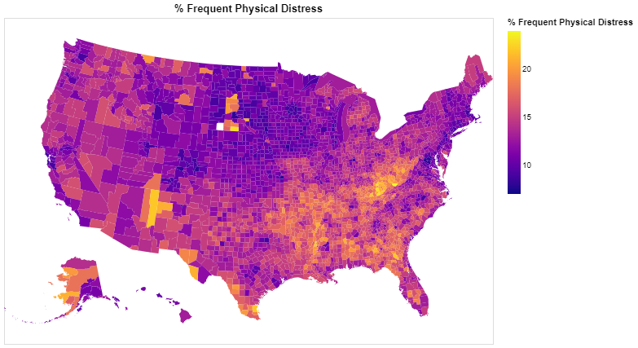
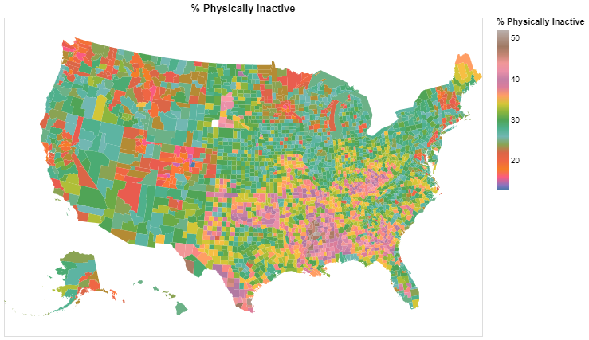
Analyzing County Health Rankings Dataset
Alexander Hasmuller | Hayden Schindler | Advisor: Dr. Erdoğan Doğdu | Angelo State University, Department of Computer Science
OVERVIEW / MOTIVATION
DESCRIPTION / QUESTIONS
RESULTS / CONCLUSIONS
SIGNIFICANT FINDINGS
This project used the county health rankings dataset for 2022 as the primary data source to investigate several potential correlations between various socioeconomic factors and important health and social outcomes. The research method involved isolating the relevant information and drawing conclusions based on the findings. Overall, this project highlights the complex relationships between socio-economic factors and health outcomes and underscores the importance of continued research in this field. The project employs data analysis techniques such as correlation analysis and visualization to draw insights from the dataset. The motivation and purpose for this project is to highlight the issues and external
factors that impact people’s mental and physical health which ultimately
determines the quality of one’s life. This project will example opportunities to
improve disparities by identifying social, racial, demographic factors that impact and predict quality of mental and physical health.
DATASET
2022 County Health Rankings Data
DESCRIPTION
> Isolate specific categories from the in order to analyze and reveal any connections
POSED QUESTIONS
Q1: Is there a connection between areas that have higher broadband access and suicide rates or an increased amount of poor mental health days?
Q2: Is there a connection between communities that have a higher number of single-parent households and the amount of teen pregnancy and or juvenile arrests?
Q3: Is there connections between areas that have higher rates of insufficient sleep and lower graduation rate/ Disconnected youth?
Q4: Can a connection be made between the area with a higher number of physically inactive days and the limited access to healthy foods/ frequent physical distress?
Q5: Are there any connections between higher suicide rates and the areas that score lower for home ownership?
Q1: Most states have 80% broadband access. So, when exploring for a correlation between suicide rates and the percentage of broadband access the amount of broadband access is too high to determine if that has an effect on the suicide rate.
Q2: When searching for a connection between the amount of single parent households and the and the teen birth rate, there appears to be a connection. The top five states for teen birthrate also appear to have a high percentage of single parent households.
Q3: It appears that there isn’t any direct correlation between the percentage of insufficient sleep and the high school graduation rate because the areas that reported the highest level of sleep inefficiency, also have the highest graduation rate in the country, but the graduation rate is high for majority of the country. That being said there does appear to be some correlation between sleep inefficiency and the percentage of disconnected youth. This can be seen in numerous counties in the states of New Mexico, Nevada, Oklahoma, Texas, Florida, and Michigan.
Q4: There didn’t appear to be a correlation between access to healthy food and either of the two categories. but there did appear to be a direct correlation between the percentage of physically inactive people and the percentage of frequent physical distress. To the point where the maps look nearly identical. This is most prominently shown in the states of Texas, Mississippi, Oklahoma, Georgia, and West Virginia.
Q5: Similar to question one, where it might be assumed that lower homeowner rate would lead to higher suicide rates, based on the bar graphs, it
appears that would be false. Looking at the lowest homeowner percent (DoC), they also have the lowest rate of suicide. and even places with much higher homeowner percentages like West Virginia or Louisiana still have a fairly high suicide rate, almost twice so compared to District of Columbia. the states with the highest suicide rates (Wyoming, New Mexico, New York, and California) also have decent
homeownership percentages.
Perhaps the most significant finding of this research is the connection between the percentage of frequent physical distress and the and the percentage of physical inactivity. Areas scoring in the range of 30-50% inactivity also scored in the range of 20-30% frequent physical distress, which are both high points for our scaling. Below are some visualizations of this connection.
% FREQUENT PHYSICAL DISTRESS
% PHYSICALLY INACTIVE
REFERENCES
County Health Rankings & Roadmaps (CHR&R) is a program of the University of Wisconsin Population Health Institute. CHR&R is known for effectively translating and communicating complex data and evidence-informed policy into accessible models, reports, and products that deepen the understanding of what makes communities healthy and inspires and supports improvement efforts. CHR&R’s work is rooted in a sincere belief in health equity, the idea that everyone deserves a fair and just opportunity to be as healthy as possible. CHR&R provides data, evidence, guidance, and examples to build awareness of the multiple factors that influence health and support leaders in growing community power to improve health equity. CHR&R produces the County Health Rankings every year. The Rankings are unique in their ability to measure the health of nearly every county in all 50 states, and are complemented by guidance, tools, and resources designed to accelerate community learning and action.
LINK
Above shows the correlation of the figures for the % Frequent physical distress and the % physically inactive.
https://www.countyhealthrankings.org/about-us.

